Slide 1
Attn Dearborn & Flint Administrators: This version contains pages modified for your campus HR processes. Please use them when viewing the video. Modified text is colored blue and shadowed for ease of reference.
Information Interchange for HR Appointment Transaction Business Processes
May 28, 2014
2-4 p.m. Palmer Commons, Forum Hall
Co Presenters:
Kris Crawford, University Human Resources
Valerie VanHaaften, Information Technology Services

Slide 2
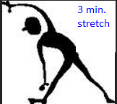
AGENDA
Introduction (How Do I Initiate a Transaction)
Technology (PAR, Security Roles, Demo)
Standards
Data Stewardship
Process Change
Job Aids
Training
Key Activity Dates

Slide 3
1. Introduction

Slide 4
Introduction Experienced By Administrators While Completing an HR Transaction
“I do not have to let you know what I am doing for this employee because the change is not in your department.” | “What is an administrative department?”
“Oh, so that’s an appointment.” | “It’s easier if I just do it this way.”
“If the system lets me do it, then it must be okay to do.” | “Prove to me that I cannot do this.”
“No, I don’t use . . . “ | “That’s not how I do it, I do it this way . . .”
“I don’t know why, I just know that this is how I was trained.” | “I know it’s in the system, but I don’t know how to use it.”
“It worked for this situation, so it should work for that situation.” | “I didn’t know you could do . . .”
“I didn’t know I should not do . . .” | “I want to know when I am doing something incorrectly . . . don’t just fix it for me.”
“My customers won’t like this . . .” | “S/he just does not get it, so I do it for her/him . . .”
“S/he doesn’t know what s/he doesn’t know.” | “It’s a new kid on the block.”
“I don’t know who can approve . . . “

Slide 5
Introduction
During the transformation of administrative services activities in 2013 and 2014, unit and central administrators volunteered to participate in the HR appointment transaction process improvement activities. The volunteers serve as an advisory committee to help with design questions, testing and training of technology changes. Initial team activities revealed the need for improved HR business standards.

Slide 6
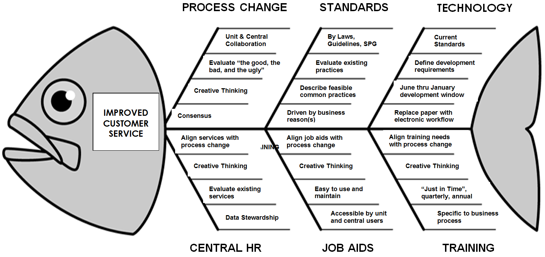
Introduction Components of Improved Customer Service

Slide 7
Introduction Effective Date of Changes
Monday, August 4, 2014
Correlates with opening date of Shared Services Center
Where should questions about Shared Services be directed?
Your Unit Representative: http://ast.umich.edu/pdfs/WebsiteUnitRepList2-18-14.pdf
Or submit questions to the AST Shared Services Project Team at ast-contact@umich.edu.

Slide 8
Introduction How Do I Initiate A Transaction

Slide 9
END OF
1. Introduction

Slide 10
2. Technology
a. PAR - Personnel Action Request
A High Level Overview

Slide 11
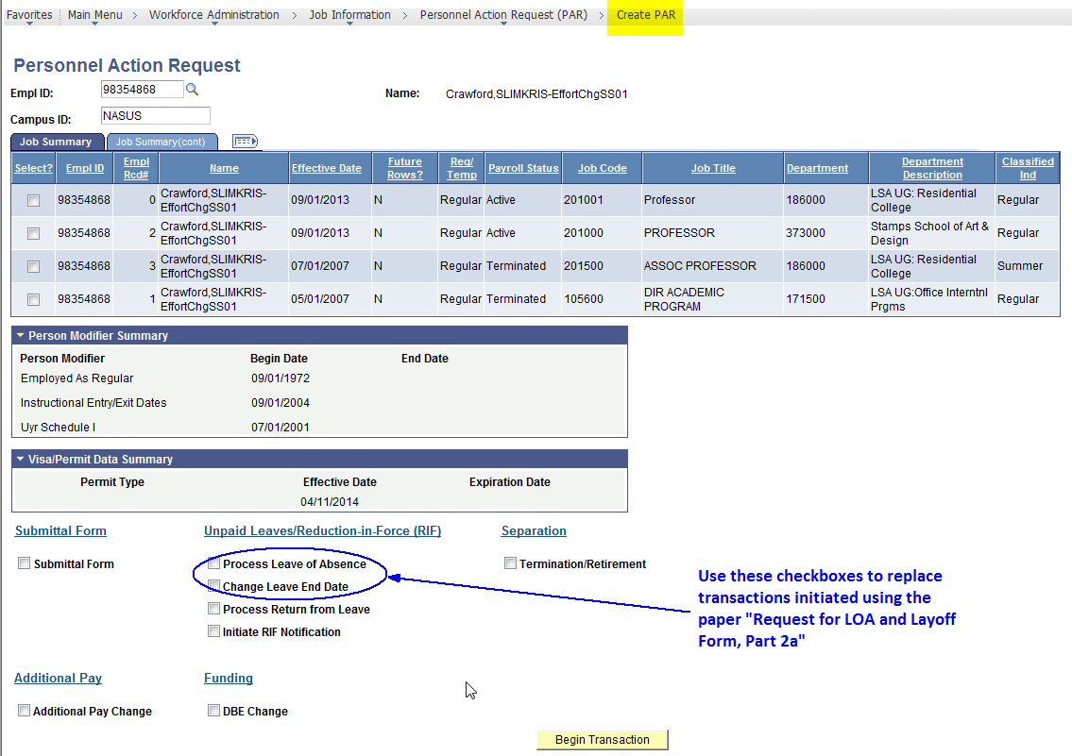
New Transactions using PAR Auto-load Upon Final Approval

Slide 12
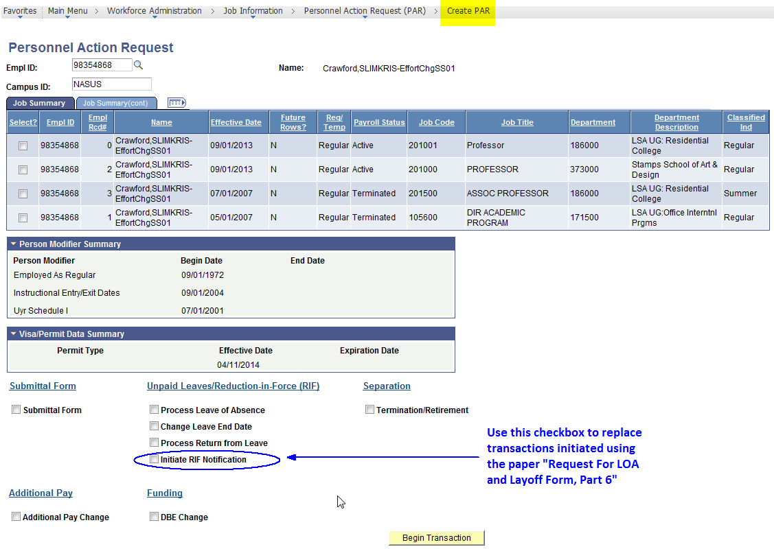
New Transactions using PAR Auto-load Upon Final Approval

Slide 13
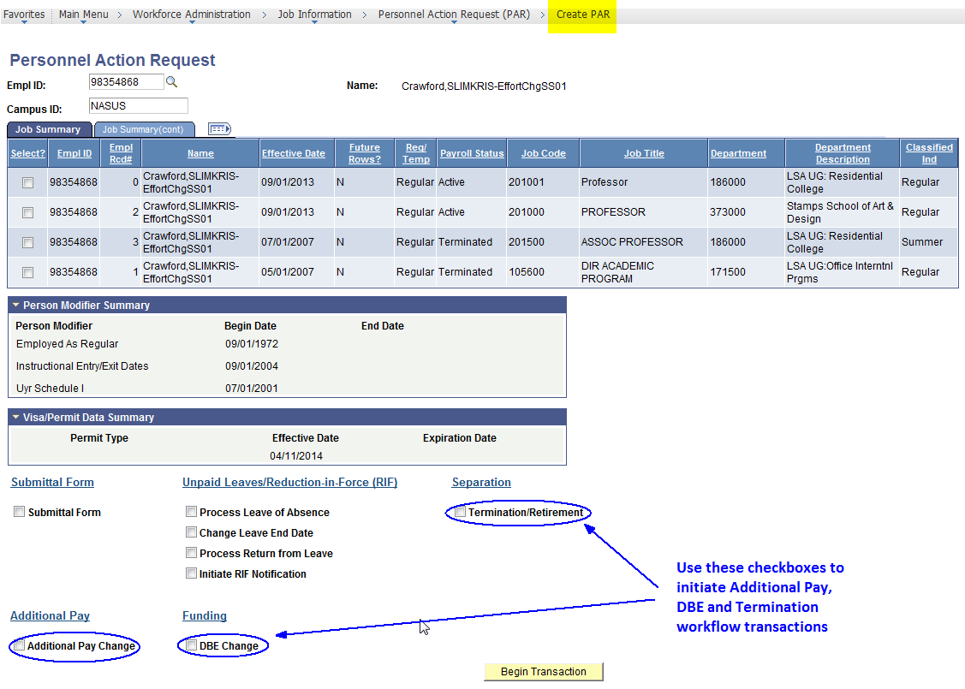
Existing Types of Transactions using PAR Auto-load Upon Final Approval

Slide 14
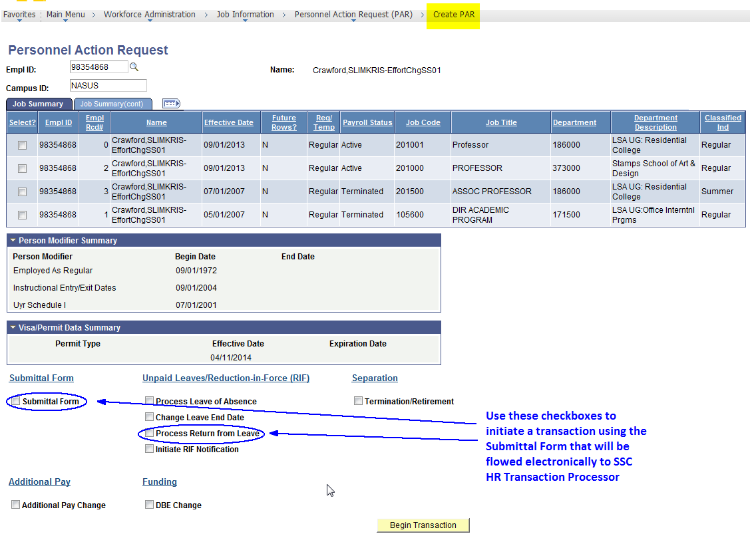
Existing Types of Transactions using PAR Manually Entered by SSC HR Transaction Processor

Slide 15
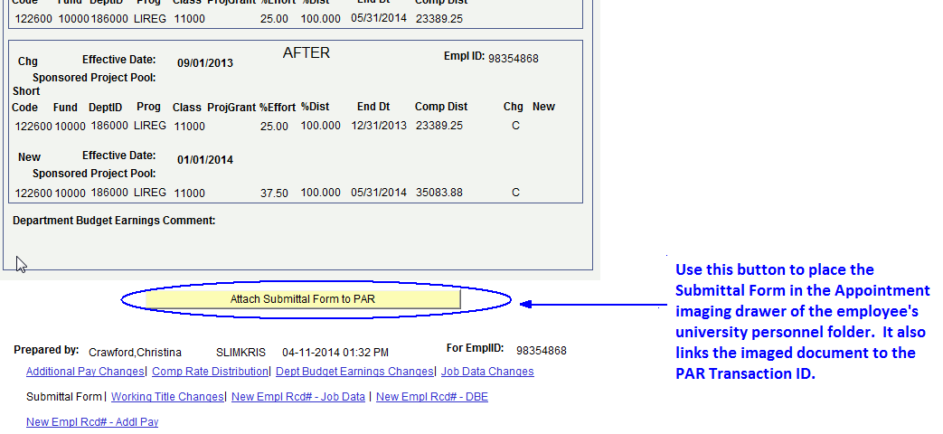
New Buttons for the Submittal Form

Slide 16
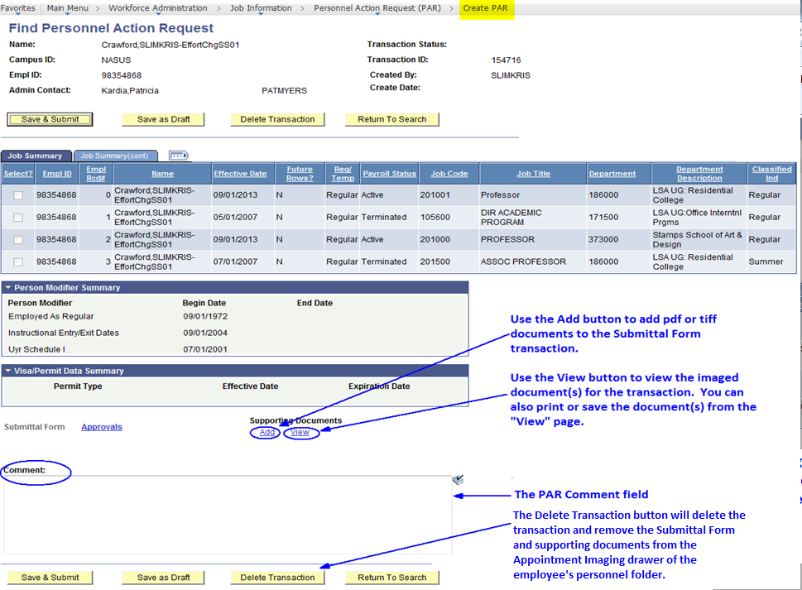
New Buttons for the Submittal Form

Slide 17
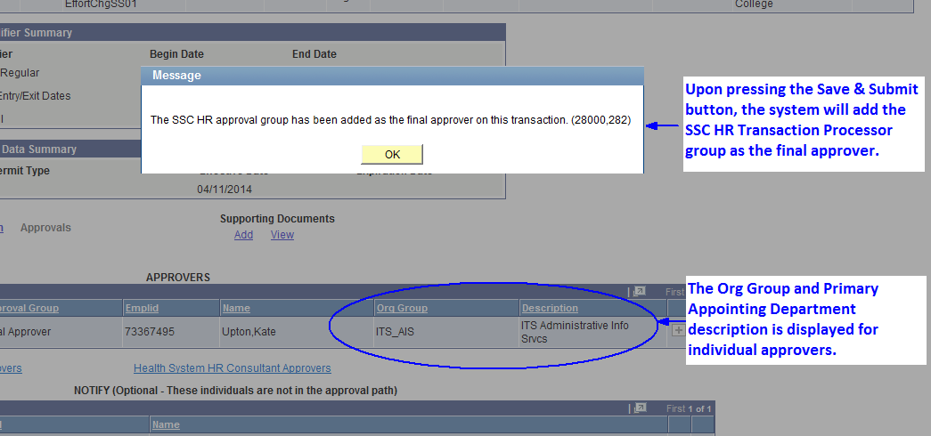
New Message for the Submittal Form Save & Submit

Slide 18
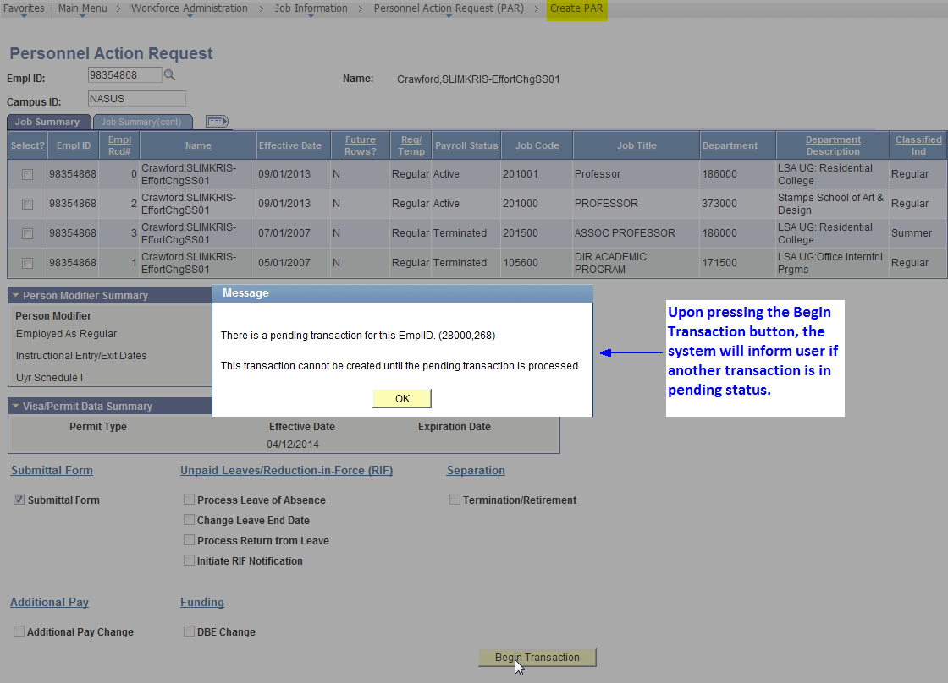
New Message for the Submittal Form Begin Transaction

Slide 19
Monitor PAR Transactions PAR Pending Approvals Page

Slide 20
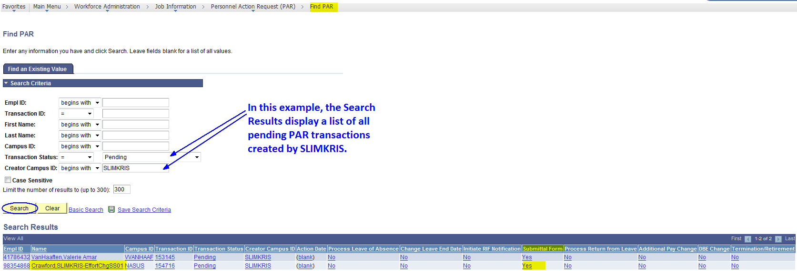
Monitor PAR Transactions Find PAR Page

Slide 21
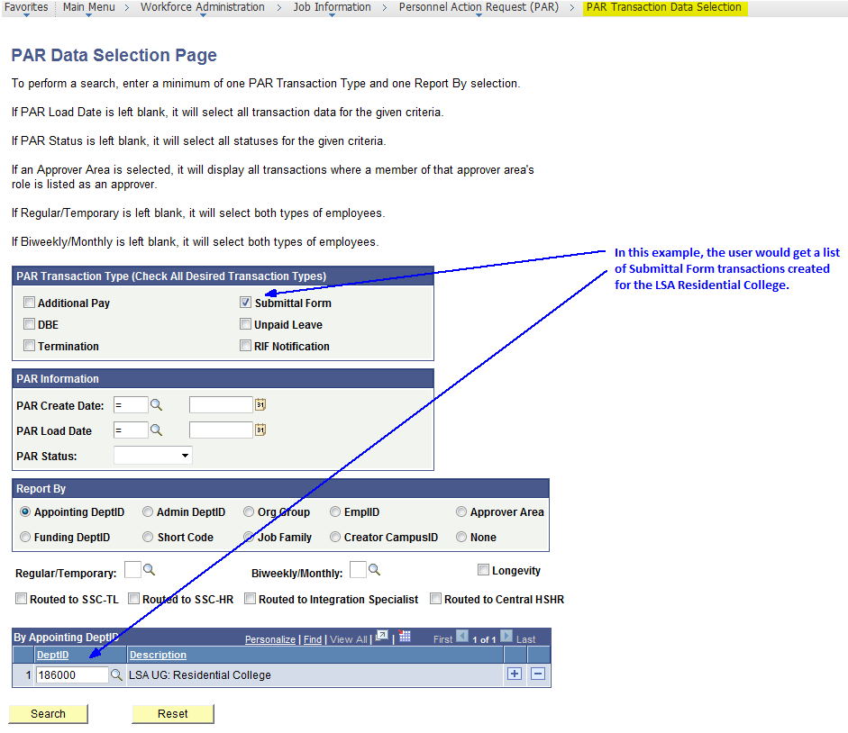
Monitor PAR Transactions PAR Transaction Data Selection Page

Slide 22
Monitor PAR Transactions PAR Transaction Data Selection Page Submittal Form Search Results

Slide 23
END OF
2. Technology
a. PAR - Personnel Action Request
A High Level Overview

Slide 24
2. Technology
b. PAR - Personnel Action Request
M-Pathways Security Roles

Slide 25
Unit HR PAR Security Roles
HR PAR UPDATER: Unit HR user who creates any of the PAR workflow transactions.
HR PAR APPROVER: Unit HR user who approves any of the PAR workflow transactions.
HR APPT VIEWER: User who views HR appointment data.

Slide 26
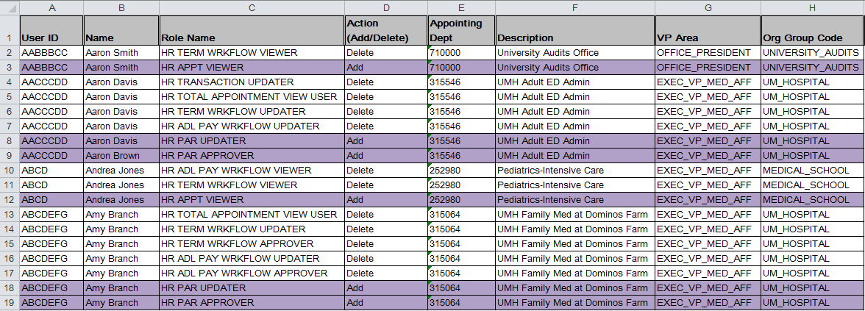
Worksheet To Be Provided to UL
If a different role is needed, update the purple “Add” row with the desired role in the Role Name column
The suggested PAR roles are listed with an action of “Add” and are highlighted in purple.
The existing workflow roles are listed with an action of “Delete.” Please do not make changes to these rows.
If an additional role is needed, insert a new row and include, at a minimum, User ID, Name, Role Name, and Action

Slide 27
END OF
2. Technology
b. PAR - Personnel Action Request
M-Pathways Security Roles

Slide 28
2. Technology
c. PAR - Personnel Action Request
Demonstration
Initiate a RIF Notification

Slide 29
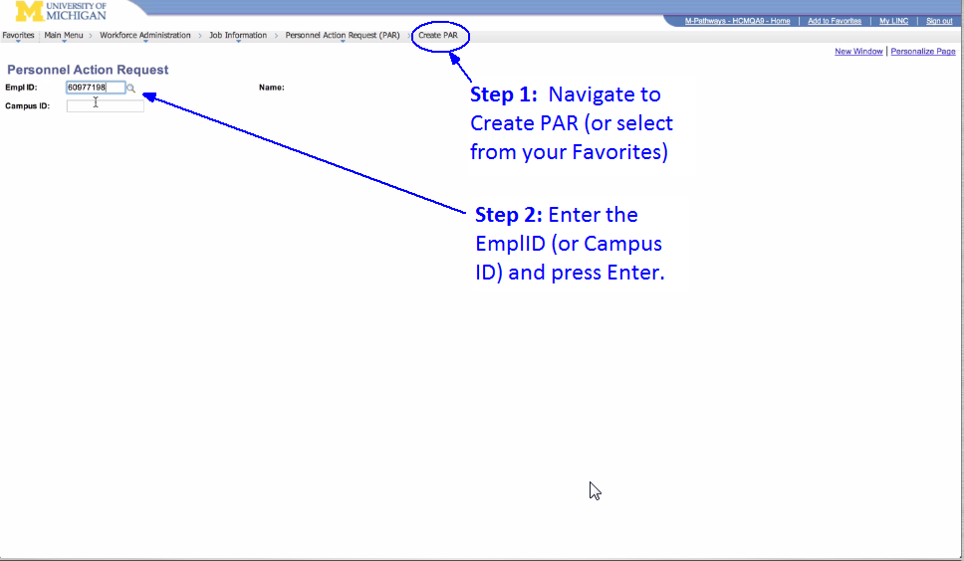
Initiate a RIF Notification Navigate and Enter EmplID

Slide 30
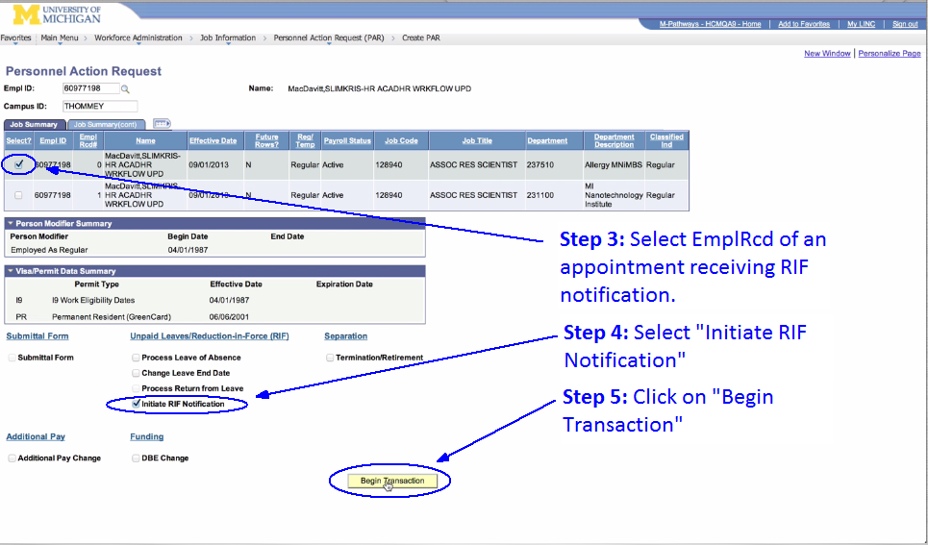
Initiate a RIF Notification Select Appt, Transaction, and Begin

Slide 31
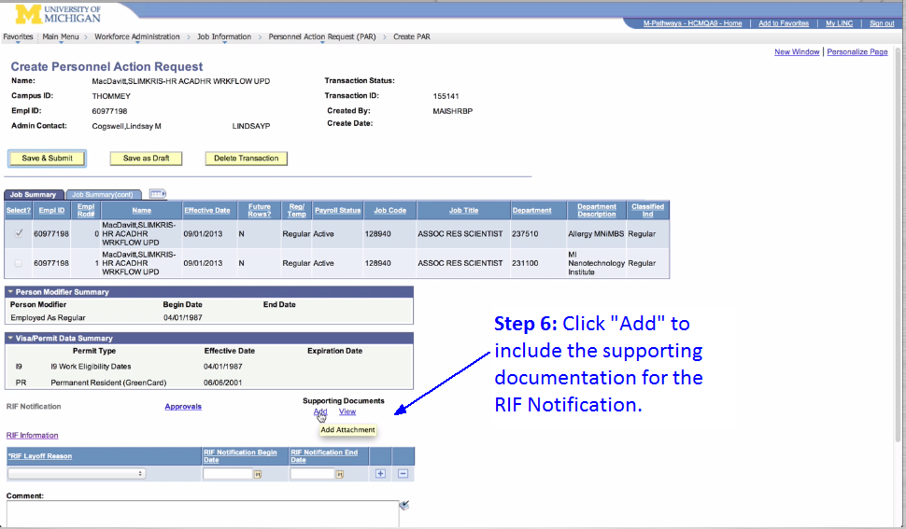
Initiate a RIF Notification Add Supporting Documentation

Slide 32
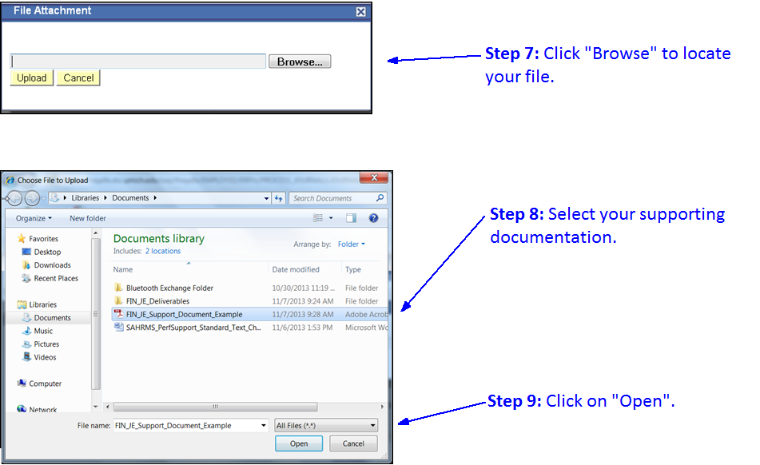
Initiate a RIF Notification Select a PDF (*.pdf) or TIF (*.tif) File

Slide 33
Initiate a RIF Notification Update Employee’s Personnel Folder

Slide 34
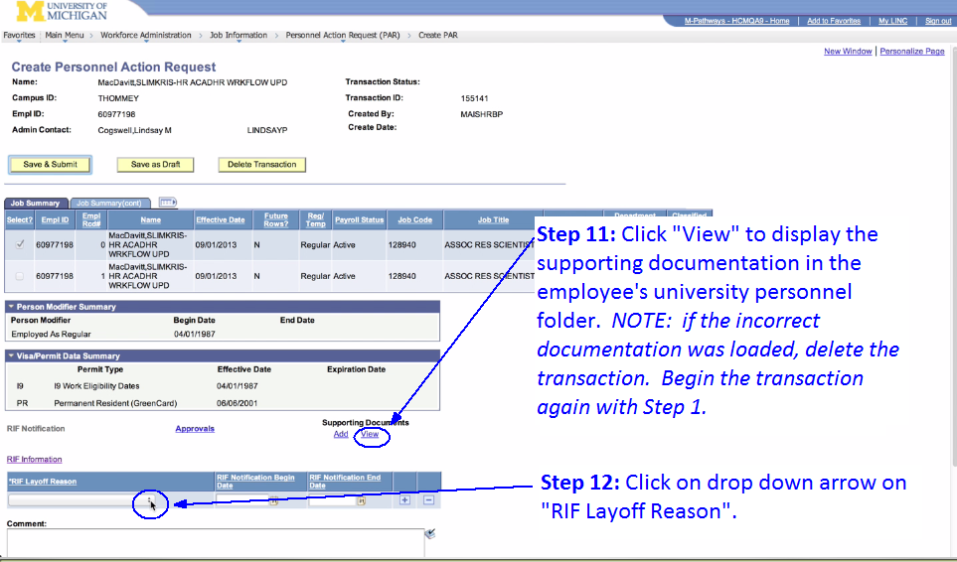
Initiate a RIF Notification View Supporting Documentation

Slide 35
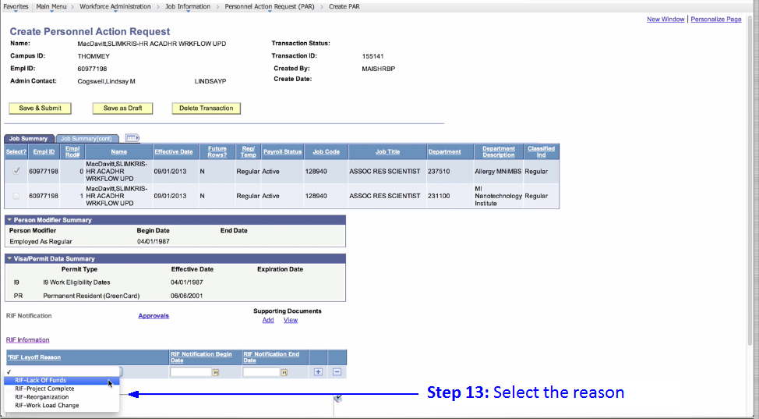
Initiate a RIF Notification Select the reason for RIF Notification

Slide 36
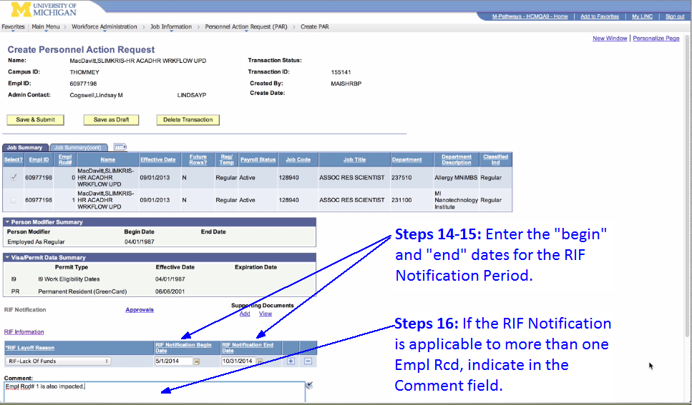
Initiate a RIF Notification Enter Notification Period and Other ERN(s)

Slide 37
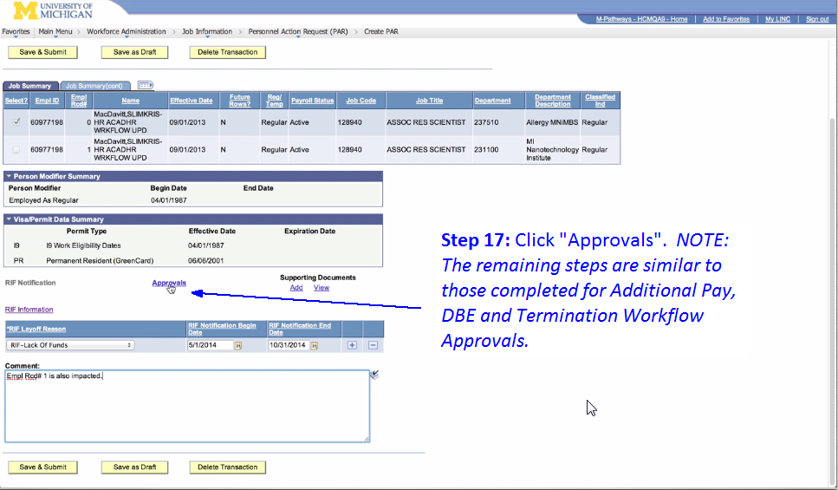
Initiate a RIF Notification Add Approvers

Slide 38
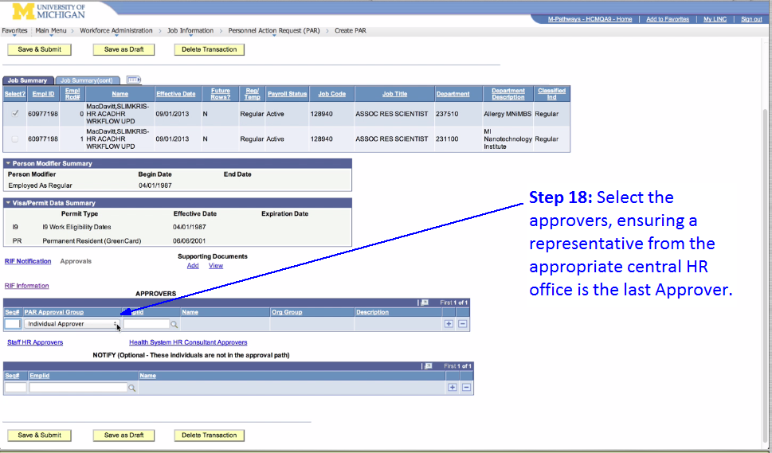
Initiate a RIF Notification Find Your Approver

Slide 39
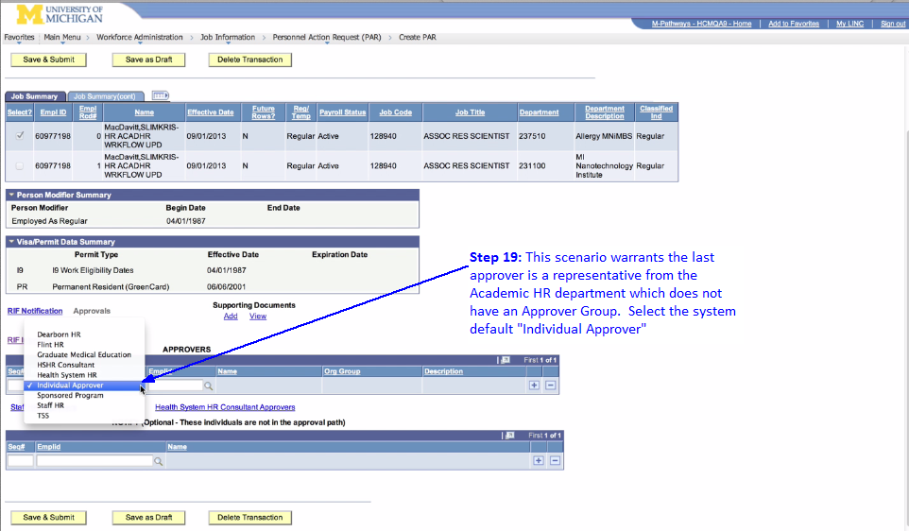
Initiate a RIF Notification Your Approver Is Not In A Group

Slide 40
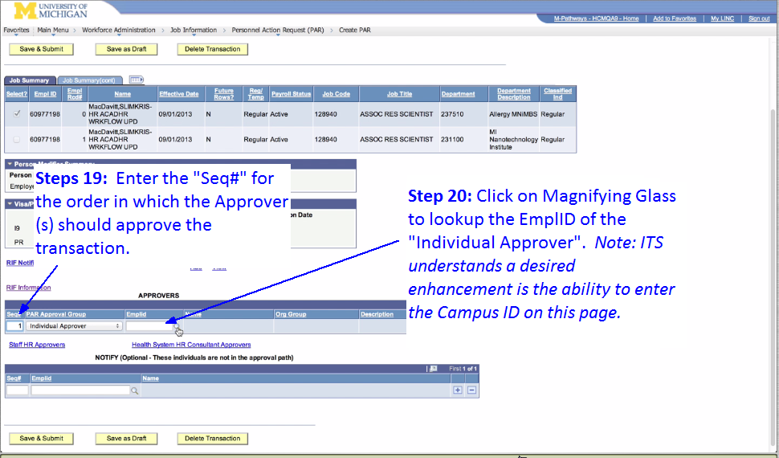
Initiate a RIF Notification Assign Seq# and Find EmplID of Approver

Slide 41
Initiate a RIF Notification Look Up the EmplID of Your Approver

Slide 42
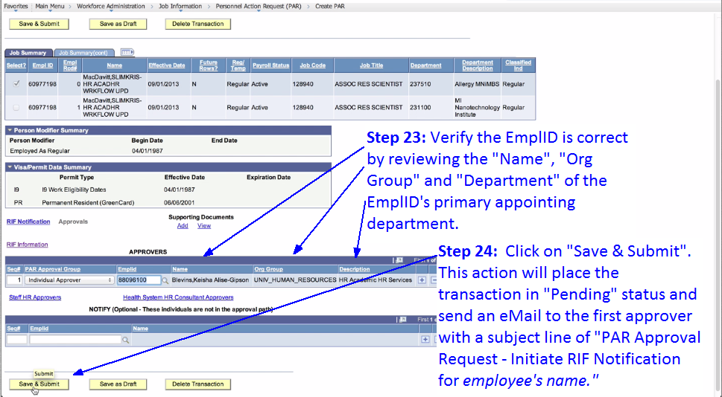
Initiate a RIF Notification Verify Correct EmplID and Save&Submit

Slide 43
END OF
2. Technology
c. PAR - Personnel Action Request
Demonstration
Initiate a RIF Notification

Slide 44
3. Standards
a. A High Level Overview

Slide 45
Standards Introduction, Approval and Endorsement
December 2013: Advisory Committee proposed standards and vetted with Unit HR Administrators that typically appointed regular faculty and staff as well as temporary employees. Approved in March 2014 to move forward.
March 2014: Academic HR championed the committee’s efforts with representatives in the Provost Office for endorsement. Endorsed March 2014.

Slide 46
Standards High Level Definitions
All HR administrators have a common understanding of the primary role of the Administrative (Home) Department.
Appointment transaction standards are sustained by university policy and practice.
An exception management process that aligns transaction standards with the expectations of centers of expertise.
Faculty and staff data stewardship that aligns with maintaining transaction standards.

Slide 47
End of
3. Standards
a. A High Level Overview

Slide 48
3. Standards
b. General

Slide 49
Standards Administrative (Home) Department
“What is an administrative department?”
The term “Administrative Department “is applicable only to regular employees.
The Administrative Department is responsible for the terms and conditions of an individual’s employment relationship with the University of Michigan.
Typically, the first hiring department of a tenure track faculty is the Administrative Department throughout the faculty member’s employment relationship with the university. Occasionally, the units may agree to change the Administrative Department for the faculty member.
A transaction for a regular employee should not be submitted without the approval of the Administrative Department.

Slide 50
Standards Communicate, Collaborate, Coordinate
“I do not have to let you know what I am doing for this employee because the change is not in your department.”
Whenever an employee has more than one appointing department, HR administrators for each appointment must be informed and agree on the intent of the appointment transaction.
A transaction should not be submitted prior to agreement on the intent of the appointment transaction.
A single administrator submits a single transaction for updates to multiple appointments.
Until a Submittal Form workflow transaction is approved or deleted, another Submittal Form workflow transaction cannot be created.
An HR Administrator can create a Submittal Form, download and eMail it to the single administrator submitting a single transaction. The HR Administrator should delete the transaction so the single administrator can create a new transaction.

Slide 51
Standards Administrative Contact
“I know it’s in the system, but I don’t know how to use it.”
The term “Administrative Contact“ is applicable to the appointing department of regular and temporary employees.
In M-Pathways eRecruit it is the employee’s supervisor.
In all other situations, it is recipient of eNotifications about an employee’s employment status as well as monthly, quarterly and annual reports of various employment and appointment transactions related to the appointing department.
If the Appointing Department DeptID does not have a “Personnel (report) Recipient” override, the Manager ID of the Appointing Department DeptID is the “Administrative Contact”.
System Constraint: Once a “Personnel (report) Recipient” override is populated, it cannot be deleted.
Frequently, the “Administrative Contact” is not the approver for an appointment transaction.

Slide 52
Standards PAR Department Final Approver
“I don’t know who can approve . . . “
Each appointing department of regular employees will have a final approver designated for the following types of appointments.
Faculty: Regular Instructional, Clinical Instructional, Research Track, Librarians, Archivists, Curators
Regular Staff: Career Job Family
GEO, GSRA and Research Fellows
LEO
House Officers
HRRIS understands users desire a similar standard for Temporary Appointments and DBE Funding Departments.

Slide 53
Standards PAR Department Final Approver Is Required
“I do not have to let you know what I am doing for this employee because the change is not in your department.”
For each transaction, approval from a Department Final Approver is required for each of the employee’s appointments.
Applicable to Submittal Form and Unpaid Leaves: if the Department Final Approver opts to provide approval in a manner other than the PAR Approval Workflow, the single administrator MUST ensure the first statement in the PAR Comment field is “ALL UNITS APPROVED”.
If an appointment does not have a required Department Final Approver in the Approval Workflow and “ALL UNITS APPROVED” is not in the PAR Comment field, the SSC HR Transaction Processor MUST deny the transaction and provide the business reason in the PAR Comment field.

Slide 54
Standards Create Transaction to System Updated
“If the system lets me do it, then it must be okay to do.”
If PAR transaction exists in “Draft”, “Pending”, or “Denied” status, another transaction for the employee cannot be created.
When an existing transaction is in “Approved” status or deleted by the transaction creator, another transaction for the employee can be created.
An appointment transaction should be updated in the system within two weeks of the “Create Date” of the transaction.
Beginning Fiscal Year 2016: An internal controls employment process for PAR workflow transactions to be created and the system updated within two weeks of the HR cutoff for payroll.

Slide 55
Standards Documentation to Personnel Folder
“I didn’t know I should not do . . .”
“I want to know when I am doing something incorrectly . . . don’t just fix it for me.”
Three (3) ways to submit paper form transactions, supplemental documentation and documents to the employee’s university personnel folder:
1. Attachment to a Submittal Form, Unpaid Leave, RIF Notification or Termination PAR transactions.
2. Campus Mail
3. FAX
Attn Dearborn and Flint Administrators: please Campus Mail, or FAX to your campus central HR representative(s).

Slide 56
Standards Documentation to Personnel Folder
“I didn’t know I should not do . . .”
“I want to know when I am doing something incorrectly . . . don’t just fix it for me.”
If your document has unique identifiers (names, EmplIDs, uniqnames) of other employees, remove them from the document before submission.
Ensure the UMID of an existing individual is on the form or in the upper right hand corner of the first page of the document.
When using a cover page and the next page is a form, ensure the cover page has the UMID in the upper right hand corner and the form’s number ~ located on the bottom left hand corner of the form ~ is on the bottom left hand corner of the cover page.

Slide 57
Standards Finding an Individual’s UMID/EmplID
“I didn’t know you could do . . .”
The HR Security Role “HR APPT VIEWER” has been modified to allow the user to search for EmplID by entering the individual’s Campus ID. This can be done by using the Add/Update a Person on-line search page.

Slide 58
Standards Inaccurate Data on Submittal Form
“My customers won’t like this . . .”
The Submittal Form is in the employee’s university personnel folder upon clicking the PAR “Attach Submittal Form” button.
The content of the Submittal Form cannot be modified by the SSC HR Transaction Processor.
The PAR Comment field is not included in the employee’s university personnel folder.
If data is inaccurate, the SSC HR Transaction Processor will deny the transaction so the Creator can make changes and resubmit. Note: If the timing of the transaction impacts pay or benefits and the inaccuracy does not impact pay/benefits, the processor will “communicate, collaborate, coordinate” with the Creator to approve the transaction with an understanding that the Creator will send a transaction to correct the inaccuracy.
If a department approver identifies an inaccuracy, the transaction should be denied so the Creator can make changes and resubmit.

Slide 59
Standards Exception Process (in progress)
“Prove to me that I cannot do this.”
“My customers won’t like this . . .”
“It’s easier if I just do it this way.”
The following flow is recommended for managing an exception to standards that directly impacts HR appointment transaction processing.
The goal is to develop a process that:
Stimulates timely exception resolution.
Provides standard documentation for exceptions.
Can shape future development of appointment transactions and enabling technology decisions.

Slide 60
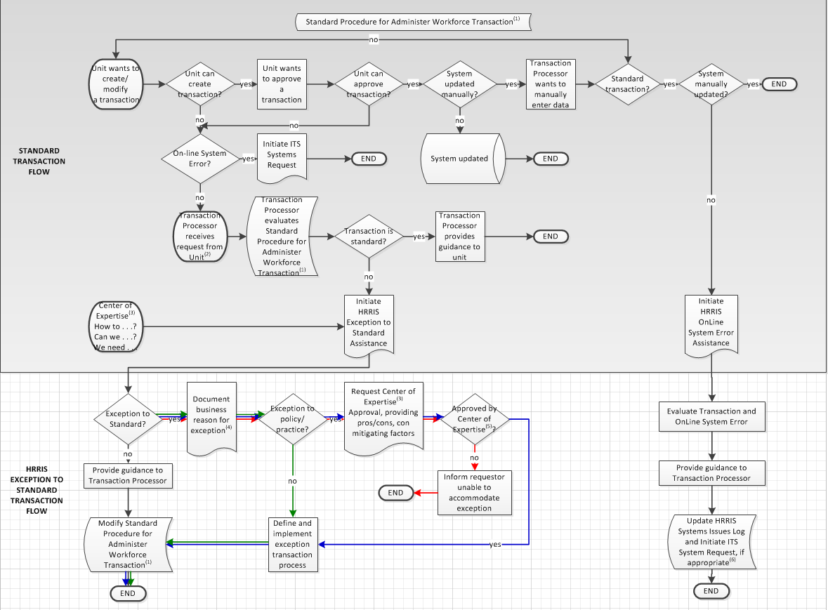
Standards Exception Process (in progress)
“Prove to me that I cannot do this.”
“My customers won’t like this . . .”
“It’s easier if I just do it this way.”

Slide 61
End of
3. Standards
b. General

Slide 62
3. Standards
c. Changes to Some Transactions

Slide 63
Standards Regents Communications
“That’s not how I do it, I do it this way . . .”
The creator of a transaction does not need to attach the Regents Communication for the SSC HR Transaction Processor.
The SSC HR Transaction Processor will use a dynamic list of approved Regents Communications maintained and provided by HRRIS to determine if an appointment requiring an approved Regents Communication can be processed.
The SSC HR Transaction Processor will access the approved communication online as part of the transaction process.
HRRIS will ensure a copy of the approved Communication is placed in the employee’s university folder.

Slide 64
Standards Acting and Interim Appointments
“That’s not how I do it, I do it this way . . .”
A Jobcode with a description that includes “Interim” will be created when the appointment to fill a vacant position is approved by the Regents.
A Jobcode with a description that includes “Acting” will be created when the appointment to fill an absence is approved by the Regents.
The Classified Indicator value of “Actg Appt” will be discontinued.
Units can continue to use “Acting” in a working title of staff as needed.

Slide 65
Standards Regents Communications and the Appointment End Date
“That’s not how I do it, I do it this way . . .”
If the Appointment End Date does not align with a Regents Communication approving the appointment, the SSC HR Transaction Processor will deny the Submittal Form transaction so the Creator can make corrections and resubmit.
Tenure granting appointments will continue to be processed with an open-ended Appointment End Date.
HRRIS will continue to batch load faculty promotions approved during the May Regents meeting. Typically this is completed within one to two working days after the Regents meeting.

Slide 66
Standards Appointment Extension
“That’s not how I do it, I do it this way . . .”
With the exception of faculty appointments, HRRIS will stop pay on all appointments with Appointment End Dates that have expired in the previous month.
Future effective dated rows terminating an appointment in the system will be discontinued.
An appointment should be extended in the system no later than one week prior to the existing appointment end date.
Beginning the first week in September 2015, HRRIS will include faculty appointments in the monthly ‘stop pay’ process.
HRRIS understands users desire to have a new tab in the monthly report sent to administrative contracts. It should provide a list of appointments approaching expiration.

Slide 67
Standards Compensation Rate Salary Distribution (DBE)
“That’s not how I do it, I do it this way . . .”
The DBE should be described for no less than the entire current fiscal year as it relates to the Appointment End Date on each Empl Rcd#.
If the FTR is described with an Appointment Period of “PER 12 MONTHS”, “HOURLY” or “BIWEEKLY” and the Appointment End Date does not expire within the current fiscal year, the DBE can be open-ended.
The SSC HR Transaction Processor will deny a Submittal Form Job transaction if the DBE is incomplete for the fiscal year.
HRRIS will continue the annual process to update eligible University Year DBE’s.
HRRIS understands users desire the ability to batch load DBE’s when appropriate. HRRIS desires to design a worksheet batch load process that will support existing Effort Certification and Sponsored Program policy.

Slide 68
Standards Overload and Summer Salary
“That’s not how I do it, I do it this way . . .”
The Appointment Begin Date will be the begin date of the Overload or Summer Salary. This is also applicable for an overload on an existing appointment.
The Appointment End Date will be the end date of the Overload or Summer Salary. This is also applicable for an overload on an existing appointment.
Once an Empl Rcd# has been assigned a Classified Indicator of “Overload”, it cannot be used for any other type of Classified Indicator.
Once an Empl Rcd# has been assigned a Classified Indicator of “Summer Salary”, it cannot be used for any other type of Classified Indicator.
Entering a future-effective dated row to terminate an Overload or Summer Salary will be discontinued.
HRRIS will use the Appointment End Date to determine if the Overload or Summer Salary should be terminated during the monthly ‘stop pay’ process.
HRRIS understands users desire the ability to batch load renewal of Summer Salary when appropriate. HRRIS desires to design a worksheet batch load process that will support existing Summer Salary policy.

Slide 69
Standards Rehire a Former Regular Employee
“That’s not how I do it, I do it this way . . .”
If the appointment cannot be processed through eRecruit, use the PAR Submittal Form to rehire a regular employee.
Use the PAR attach button to submit supplemental documentation.
The Appointment Request form will be renamed “New Hire Appointment Request.”
NOTE: If the individual does not have an existing Submittal Form record of regular appointment(s) and the appointment cannot be processed through eRecruit, use the “New Hire Appointment Request” form.

Slide 70
Standards Intergovernment Personnel Assignment
“That’s not how I do it, I do it this way . . .”
If a non-faculty employee is approved for an Intergovernment Personnel Assignment, use the Faculty Leave of Absence Request paper form to initiate the leave.

Slide 71
End of
3. Standards
c. Changes to Some Transactions

Slide 72
4. Data Stewardship

Slide 73
Data Stewardship
“Prove to me that I cannot do this.”
“It’s easier if I just do it this way.”
If a unit experiences “intentional disregard” from another unit regarding standards this should be escalated to HRRIS for resolution.
SUGGESTION: If you opt to develop an approval agreement between units on certain transactions that can be done without additional approval, please consider sending this agreement to HRRIS. This will expedite issue resolution.

Slide 74
Data Stewardship Regents Communications
“Prove to me that I cannot do this.”
“It’s easier if I just do it this way.”
HRRIS will monitor each Regents Meeting agenda and minutes for decisions that impact appointment transactions.
HRRIS will monitor the system data and university personnel folder to ensure appointments requiring Regents Communications have been appropriately processed.
HRRIS will work with University Compensation to ensure “Acting” and “Interim” Jobcodes are available upon a Regents Communication approval.

Slide 75
Data Stewardship Monitoring Data Integrity
“Prove to me that I cannot do this.”
“It’s easier if I just do it this way.”
HRRIS will evaluate and modify existing audit queries and change internal processes to support new standards.
HRRIS will ‘communicate, collaborate and coordinate’ with SSC to maintain and develop interoperable services.

Slide 76
Data Stewardship Tier 3 Support to SSC
“Prove to me that I cannot do this.”
“It’s easier if I just do it this way.”
HRRIS will provide expertise in handling complex transactions, exceptions to transaction standards as well as ad hoc HR report support.

Slide 77
End of
4. Data Stewardship

Slide 78
5. Process Change

Slide 79
Process Change First Point of Contact
Attn Dearborn and Flint Administrators: This page is only applicable to your campus Central HR representative(s).
Shared Services Center
Call (734) 615-2000
FAX (734) 763-1283
Campus Mail (one of two addresses)
SSC HR
Wolverine Tower
3003 South State Street
Ann Arbor, MI 48109-1276
SSC Personnel File Only
Wolverine Tower
3003 South State Street
Ann Arbor, MI 48109-1271

Slide 80
Process Change First Point of Contact
Attn Dearborn and Flint Administrators: This page is only applicable to your campus Central HR representative(s).
Shared Services Center
SSC.HR.AWF.Exception@umich.edu
Unit administrator's request for an exception to standard. Initially members will be HRRIS staff only and limited to HR Transaction Processing.
SSC.HR.Alternative.Process@umich.edu
Unit administrator's request for an alternative to processing a group of appointment updates one transaction at a time. Initially members will be HRRIS staff only and limited to HR Transaction Processing.

Slide 81
Process Change First Point of Contact
Attn Dearborn and Flint Administrators: This page is only applicable to your campus Central HR representative(s).
Shared Services Center
SSC.HR.Batch.Toolkit@umich.edu
Unit administrator's request either the "One Time Additional Pay" or "Work Address/Phone" Batch Toolkit. The eMail will replace the HRRIS Customer Service Team eMail group currently in the MyLinc Documentation.
SSC.HR.Emp.Verification@umich.edu
Employee/External Vendor/Unit Administrator requests for a hard copy Employment Verification.

Slide 82
Process Change First Point of Contact
Shared Services Center
SSC.HR.Transaction.Support@umich.edu
Assistance with creating a transaction. SSC will assist a user in determining if ITS Customer Support is required.
Assistance with using M-Pathways self-service (Pay Rate Change, Supervisor ID Upload, Student Temporary Processing or People Pay Decision Tool).
Assistance with using HRRIS Job Aids.

Slide 83
Process Change First Point of Contact
Attn Dearborn and Flint Administrators: This page is only applicable to your campus Central HR representative(s).
Shared Services Center
SSC.HR.Transaction.Urgent@umich.edu
Unit administrator's request to stop an HR transaction from being processed.
Unit administrator’s request to move a transaction up in the ‘work to be done’ queue.
Unit administrator reports a data entry error.

Slide 84
Process Change
A blank page inserted to replace the original page “84”, identified during the presentation as a duplicate of page “80”.

Slide 85
Process Change First Point of Contact
Shared Services Center
HR Reports Support
Call the Shared Services Center. The SSC representative will need to ask the user questions before assigning the ServiceLink Case.

Slide 86
Process Change First Point of Contact Notables
HRRISISSUES@umich.edu
This eMail group will be discontinued.
Sabbatical Request (Form J)
The Campus Mailing Address and the HRRIS process will not change.
HRRIS.Job.Aids@umich.edu
This eMail group receives communications on updates to HRRIS.Job.Aids as they become available. It is self joinable/unjoinable.

Slide 87
Process Change Enabling Technology
Attn Dearborn and Flint Administrators: This bullet is only applicable to your campus Central HR representative(s).
ServiceLink
FAX’ed or Campus Mail appointment transactions will create a ServiceLink Case, similar to the ITS Incident.
The transaction documents are imaged into the employee’s university personnel folder using the UMID you have provided.
After manually entering a transaction, the SSC HR Transaction Processor will eMail you and close the ServiceLink Case.
Adobe Acrobat Pro
HRRIS recommends, if possible, administrators upgrade from “Adobe Acrobat Reader” to “Adobe Acrobat Pro”.
It provides the ability to make updates to PDF documents on the user’s desktop with efficiency.

Slide 88
Process Change Technology and the University Long Title
HRRIS is evaluating the process to create University Long Title that will align with an automated appointment workflow process. There are some changes that need to occur before we can begin an evaluation:
The 150 character long description for a DeptID is included in the M-Pathways HRMS Dept Table.
The University Long Title field length changed to unlimited characters.
The steps to make these changes are in progress.
GOAL: Eliminate the need for abbreviation standards and create an automated HRRIS batch load for the complex, typically faculty, University Long Titles.

Slide 89
End of
5. Process Change

Slide 90
6. Job Aids

Slide 91
HRRIS Job Aid How To Videos (in progress)
“That’s not how I do it, I do it this way . . .”
“I didn’t know you could do . . .”
Administrative Contact (Personnel Recipient) - How to change an | Administrative Department - How to change an
Existing Empl Rcd and New Empl Rcd – How to create a single transaction for an | Favorite in M-Pathways HRMS – How to make a
OARS for a Transfer – How to process a | PDF document to delete a page – How to edit
PDF document to remove text on a page – How to edit | Submittal Form Additional Pay Earn Code – How to Add
Submittal Form and eMail to an Administrator – How to create a | Submittal Form Effective Dated Rows From Search Results – How to select
Submittal Form Effective Sequence Numbers – How to use | Submittal Form Fields Overridden When DeptID Changes – How to identify
Submittal Form Fields Overridden When Jobcode Changes – How to identify | Submittal Form Transfer to DeptID Never Used on Empl Rcd – How to create a
Submittal Form Transfer to DeptID Previously Used on Empl Rcd – How to create a | Summer Salary – various “How to” videos
Submittal Form FTR Override – How to do a

Slide 92
HRRIS Job Aid Managing Administrative Contacts
“I know it’s in the system, but I don’t know how to use it.”
HRRIS will maintain a list of “Administrative Contacts” for each appointing department.
The list will be updated monthly using the data in the system.
The job aid should assist a department in timely management of the DeptID’s “Personnel (report) Recipient” override.

Slide 93
HRRIS Job Aid Administrative Contact (in progress)
“I know it’s in the system, but I don’t know how to use it.”

Slide 94
HRRIS Job Aid Managing PAR Final Approvers for Job Updates
“I know it’s in the system, but I don’t know how to use it.”
HRRIS will maintain a list of PAR Final Approvers for each appointing department.
Attn Dearborn and Flint Administrators: your central HR representative(s) is the PAR Department Final Approver for all of your campus appointing departments.
The list will be updated monthly using the data in the system and, when necessary, solicited information from departments.
The job aid should assist a user in identifying the Final Approver from a department for an appointing department.
ITS understands the desired enhancement to have this accessible as a link on the PAR Approvers page.

Slide 95
HRRIS Job Aid Final Approver (in progress)
“I know it’s in the system, but I don’t know how to use it.”

Slide 96
HRRIS Job Aid Other Job Aids in progress
“I know it’s in the system, but I don’t know how to use it.”
Standards for the Administrative (Home) Department HR Administrator (will be accessible as on-line page through Academic HR)
Administer Workforce (AWF) HR Transaction Procedures OnLine Tool (Accessible and useful to unit and central office administrators as well as HR Transaction Processor)
Recommended HR Administrator Security Profile (M-Pathways Systems, Imaging, and Reporting)
How To Use M-Pathways Operational Reports (PAR Data Selection Report, Pay Rate Change Selection Report)
On Line Compensation Rate and FTR Calculator (for all appointment periods including U-Year)

Slide 97
End of
6. Job Aids

Slide 98
7. Training

Slide 99
Training MyLINC e-Learning Courses
“I know it’s in the system, but I don’t know how to use it.”
HRE103: Unit: Viewing Employee Data in Workforce Administration
(Recommended training for HR APPT VIEWER)
HRE104: Unit: Approving Personnel Action Request (PAR) Transactions
(Mandatory training for HR PAR APPROVER)
HRE107: Unit: Processing Personnel Action Request (PAR) Transactions
(Mandatory training for HR PAR UPDATER)

Slide 100
Training MyLINC Simulations (in progress)
“I know it’s in the system, but I don’t know how to use it.”
Find PAR
Submittal Form
Process Leave of Absense
Change Leave End Date
Process Return from Leave
Initiate RIF Notification
Termination/Retirement
Additional Pay
DBE
Data Selection
Approve

Slide 101
Training Customer Focus Practice Labs
“I know it’s in the system, but I don’t know how to use it.”
Practice Labs will be offered in June-July
Recommend you watch the video of this presentation prior to June Lab dates; and complete eLearning courses prior to July practice labs
Users can register for one hour sessions, maximum allowable users per session are 16.
6/10: 8-9 (WoTo Training Room 4)
6/12: 8-9 (WoTo Training Room 4)
6/13: 8-9 and 4-5 (WoTo Training Room 4)
7/23 8-12 (WoTo Training Room 1)
7/24 1-5 (WoTo Training Room 1)
7/28 8-12 (WoTo Training Room 1)
7/29 8-5 (WoTo Training Room 1)
Special unit sessions available upon request and as able to accommodate .

Slide 102
Training HRRIS Service (in progress)
“I know it’s in the system, but I don’t know how to use it.”
HRRIS representative(s) will be the practice lab facilitators.
HRRIS will contact a representative of an organizational group to help define the PAR Department Final Approver during the months of June and July.
Long Term Plans:
Monthly Newsletter
Quarterly HR Unit Administrators Working Meeting
Newly Hired/Newly Transferred Unit Administrator Training
Just-in-Time Hands On Assistance

Slide 103
End of
7. Training

Slide 104
8. Key Activity Dates

Slide 105
Key Activity Dates June 2014 thru August 2014
6/18/14: Special HR UL Presentation.
6/23/14: Security Role Worksheets are sent to HR UL’s .
7/23/14: Security Role Mappings are due to ITS.
7/23/14: ITS Access and Accounts will not process any outstanding OARS requests for the security roles that will be deleted.
8/1/14: All transactions that do not have an approved status by end of business will be deleted from the system.
8/4/14: M-Pathways PAR is available and the aforementioned goes into effect.

Slide 106
Key Activity Dates September 2014 thru September 2015
February 2015: The 150 character description of the DeptID will be a field in the M-Pathways HRMS Dept Table.
February 2015: The University Long Title will be an unlimited data field.
5/1/2015: If a unit does not use the HRRIS GSA Worksheet process to reappointment GSA’s, the unit should use the eRecruit system.
9/1/2015: The HRRIS ‘stop pay’ row monthly process will include faculty appointment end dates that have expired in the previous month.

Slide 107
End of
8. Key Activity Dates

